Slide 1
We are Children of the World
Track 4: Punjabi/Urdu
A multi-lingual music project celebrating the many languages of young people in this country.
Click to begin slide

Slide 2
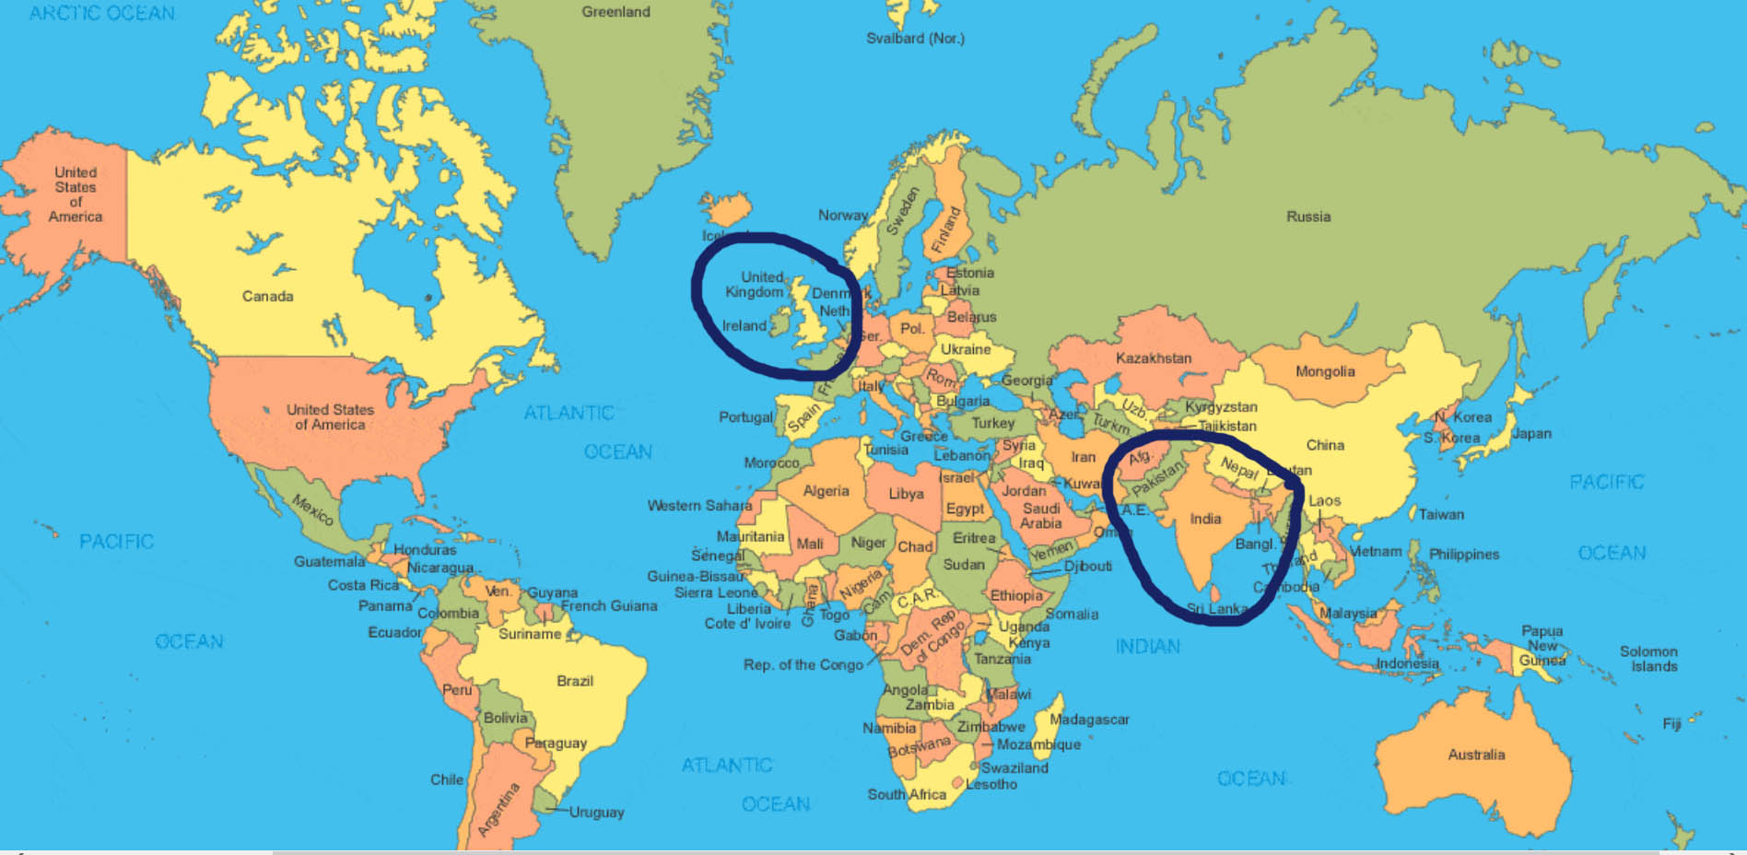
Track 4: Punjabi/Urdu

Slide 3

Track 4: Punjabi/Urdu

Slide 4
Punjabi 1.1
Ala-la-ra
ba-la-ra
babay dee

Slide 5
Punjabi 1.1
Ala-la-ra
ba-la-ra
babay dee

Slide 6
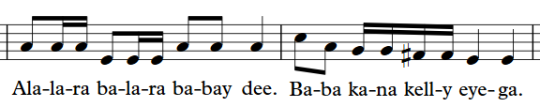
Punjabi 1.2

Slide 7
Punjabi 1.2

Slide 8
Punjabi 1.3
Ba ba kana kelly eye ga

Slide 9
Punjabi 1.3
Ba ba kana kelly eye ga

Slide 10
Punjabi 1.4

Slide 11
Punjabi 1.4

Slide 12
Punjabi 1.5

Slide 13
Punjabi 1.5

Slide 14
Punjabi 2.1
Babee becki chatay ghi*
*Phonetic spelling

Slide 15
Punjabi 2.1
Babee becki chatay ghi*
*Phonetic spelling

Slide 16
Punjabi 2.2
Nah-lay chhan katteghi

Slide 17
Punjabi 2.2
Nah-lay chhan katteghi

Slide 18
Punjabi 2.3
Babee becki chatay ghi
Nah-lay chhan katteghi

Slide 19
Punjabi 2.3
Babee becki chatay ghi
Nah-lay chhan katteghi

Slide 20
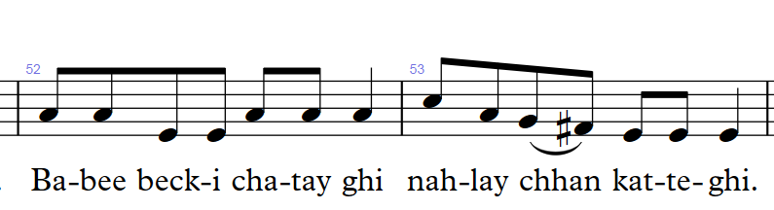
Punjabi 2.4

Slide 21
Punjabi 2.4

Slide 22
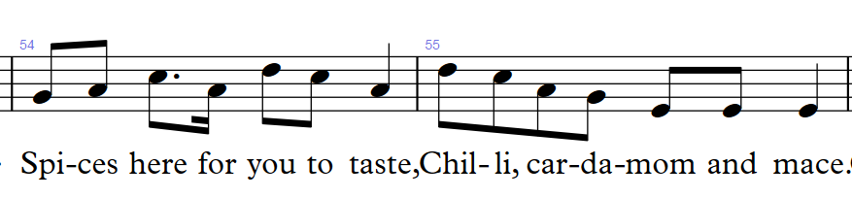
Punjabi 3.1

Slide 23
Punjabi 3.1

Slide 24
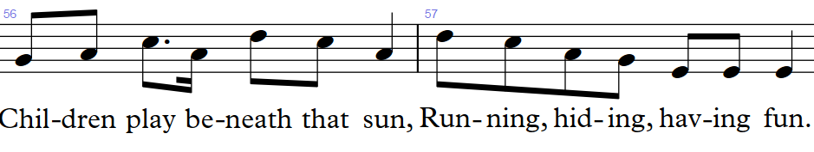
Punjabi 3.2

Slide 25
Punjabi 3.2

Slide 26
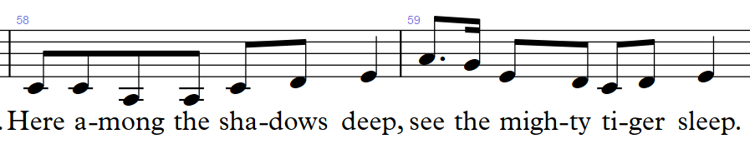
Punjabi 3.3

Slide 27
Punjabi 3.3

Slide 28
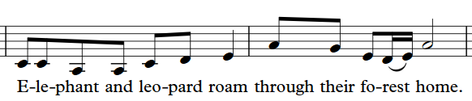
Punjabi 3.4

Slide 29
Punjabi 3.4

Slide 30


Slide 31
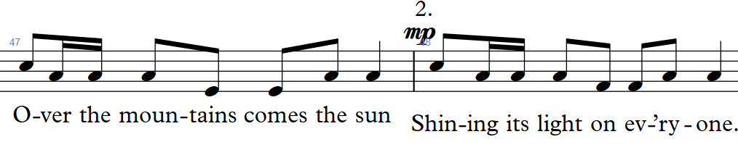
Punjabi 5.1

Slide 32
Punjabi 5.1

Slide 34
Urdu 1.0

Slide 35
Urdu 1.0

Slide 36
Urdu 1.1
Ek pyasa kawa tha
Jug mein thoda pani tha*
*phonetic spelling

Slide 37
Urdu 1.1
Ek pyasa kawa tha
Jug mein thoda pani tha*
*phonetic spelling

Slide 38
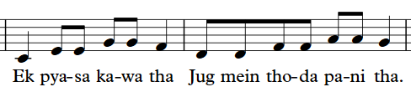
Urdu 1.2

Slide 39
Urdu 1.2

Slide 40
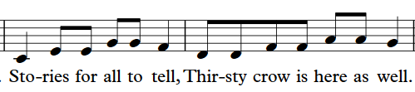
Urdu 1.3

Slide 41
Urdu 1.3

Slide 42
Urdu 1.4

Slide 43
Urdu 1.4

Slide 44
Urdu 2.1
Kawa dala kankar
Pani aya upar

Slide 45
Urdu 2.1
Kawa dala kankar
Pani aya upar

Slide 46
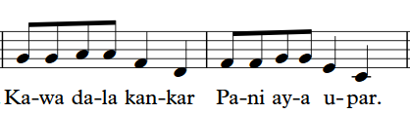
Urdu 2.2
Kawa dala kankar Pani aya upar MUSIC

Slide 47
Urdu 2.2
Kawa dala kankar Pani aya upar MUSIC

Slide 48
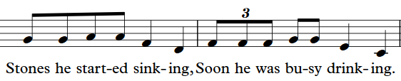
Urdu 2.3

Slide 49
Urdu 2.3

Slide 50
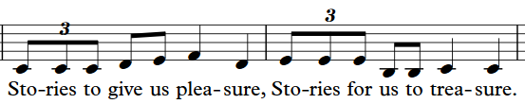
Urdu 2.4

Slide 51
Urdu 2.4

Slide 54
Well done!
Click return to begin again, arrows to move back or click to go to a track below:
Track 1 - Chorus
Track 2 – Pre-chorus
Track 3 – Opening and Mandarin
Track 4 – Punjabi/Urdu
Track 5 – Arabic
Track 6 - Polish
Track 7 – Swahili
Track 8 – Portuguese
Track 9 – Altogether! Full Run

