Slide 1
We are Children of the World
Track 6: Polish
A multi-lingual music project celebrating the many languages of young people in this country.
Click to begin slide

Slide 2
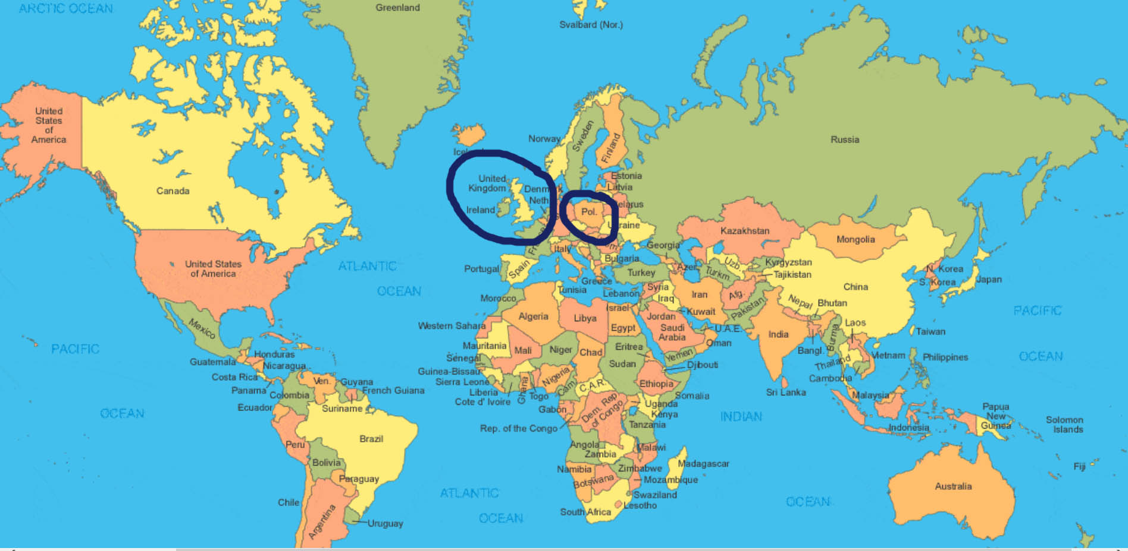
Track 6: Polish

Slide 3

Track 6: Polish

Slide 4
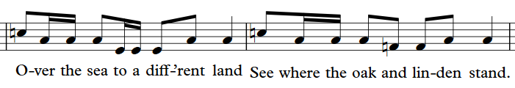
Polish 1.1

Slide 5
Polish 1.1

Slide 6
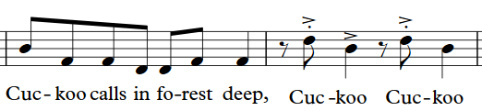
Polish 1.2

Slide 7
Polish 1.2

Slide 8
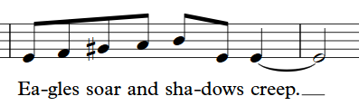
Polish 1.3

Slide 9
Polish 1.3

Slide 10
Polish 2.1
Szla dzie-wecz-ka
do la-secz-ka

Slide 11
Polish 2.1
Szla dzie-wecz-ka
do la-secz-ka

Slide 12
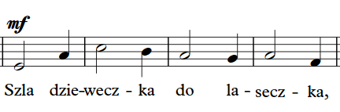
Polish 2.2

Slide 13
Polish 2.2

Slide 14
Polish 2.3
Do zie-lo-ne-go

Slide 15
Polish 2.3
Do zie-lo-ne-go

Slide 16
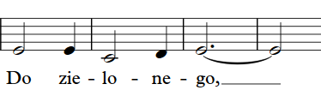
Polish 2.4

Slide 17
Polish 2.4

Slide 18
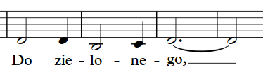
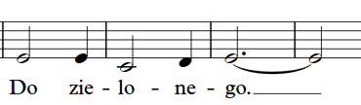
Polish 2.5

Slide 19
Polish 2.5

Slide 20
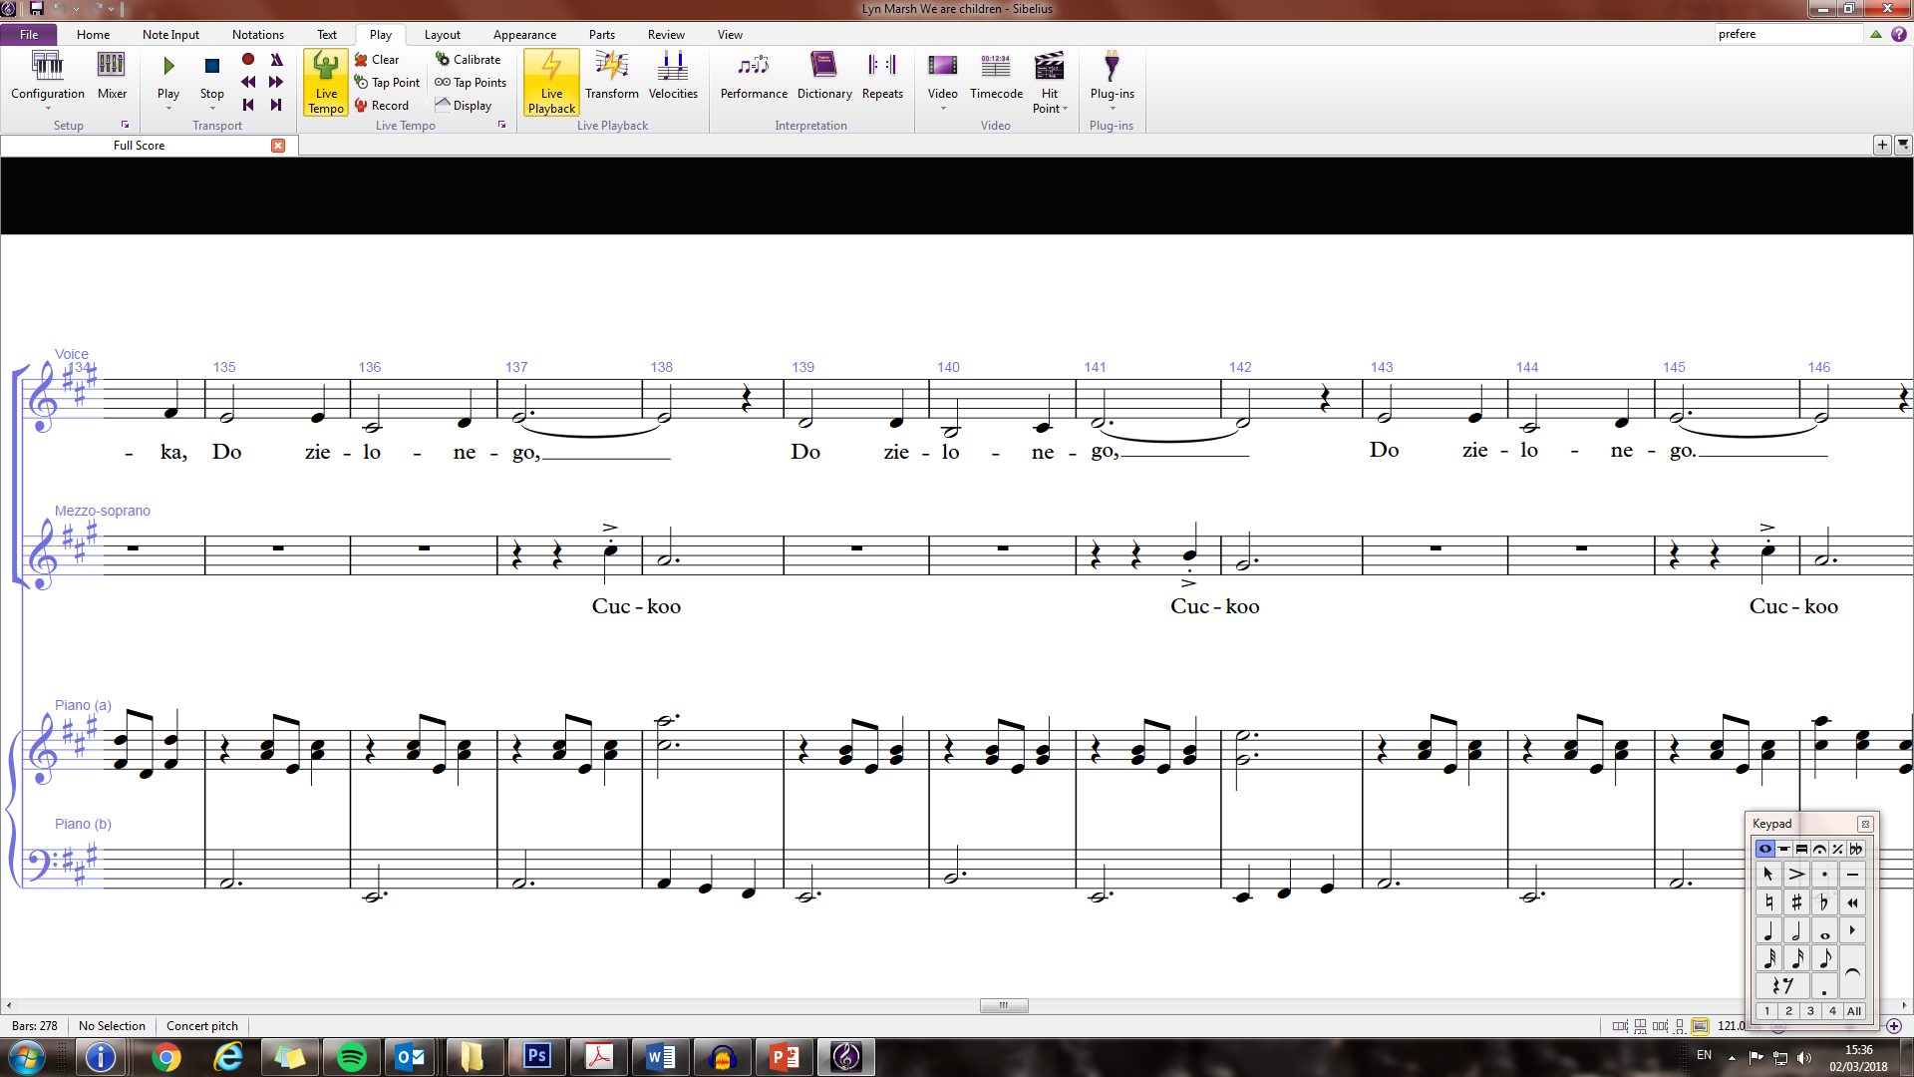
Polish 2.6

Slide 21
Polish 2.6

Slide 22


Slide 23
Polish 3.1
Na-pot-ka-la
Mys-li-wecz-ka
Bar-dzo szwar-ne-go (x3)

Slide 24
Polish 3.1
Na-pot-ka-la
Mys-li-wecz-ka
Bar-dzo szwar-ne-go (x3)

Slide 25
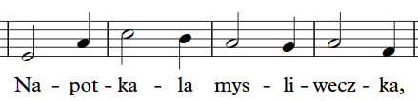
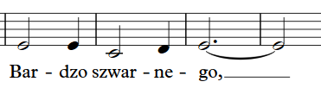

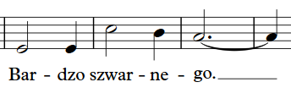
Polish 3.2

Slide 26
Polish 3.2

Slide 28

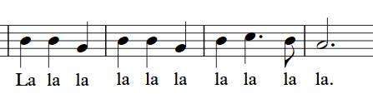
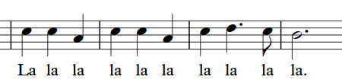

Polish 4.1

Slide 29
Polish 4.1

Slide 31
Well done!
Click return to begin again, arrows to move back or click to go to a track below:
Track 1 - Chorus
Track 2 – Pre-chorus
Track 3 – Opening and Mandarin
Track 4 – Punjabi/Urdu
Track 5 – Arabic
Track 6 - Polish
Track 7 – Swahili
Track 8 – Portuguese
Track 9 – Altogether! Full Run

