Slide 1
We are Children of the World
Track 8: Portuguese
A multi-lingual music project celebrating the many languages of young people in this country.
Click to begin slide

Slide 2
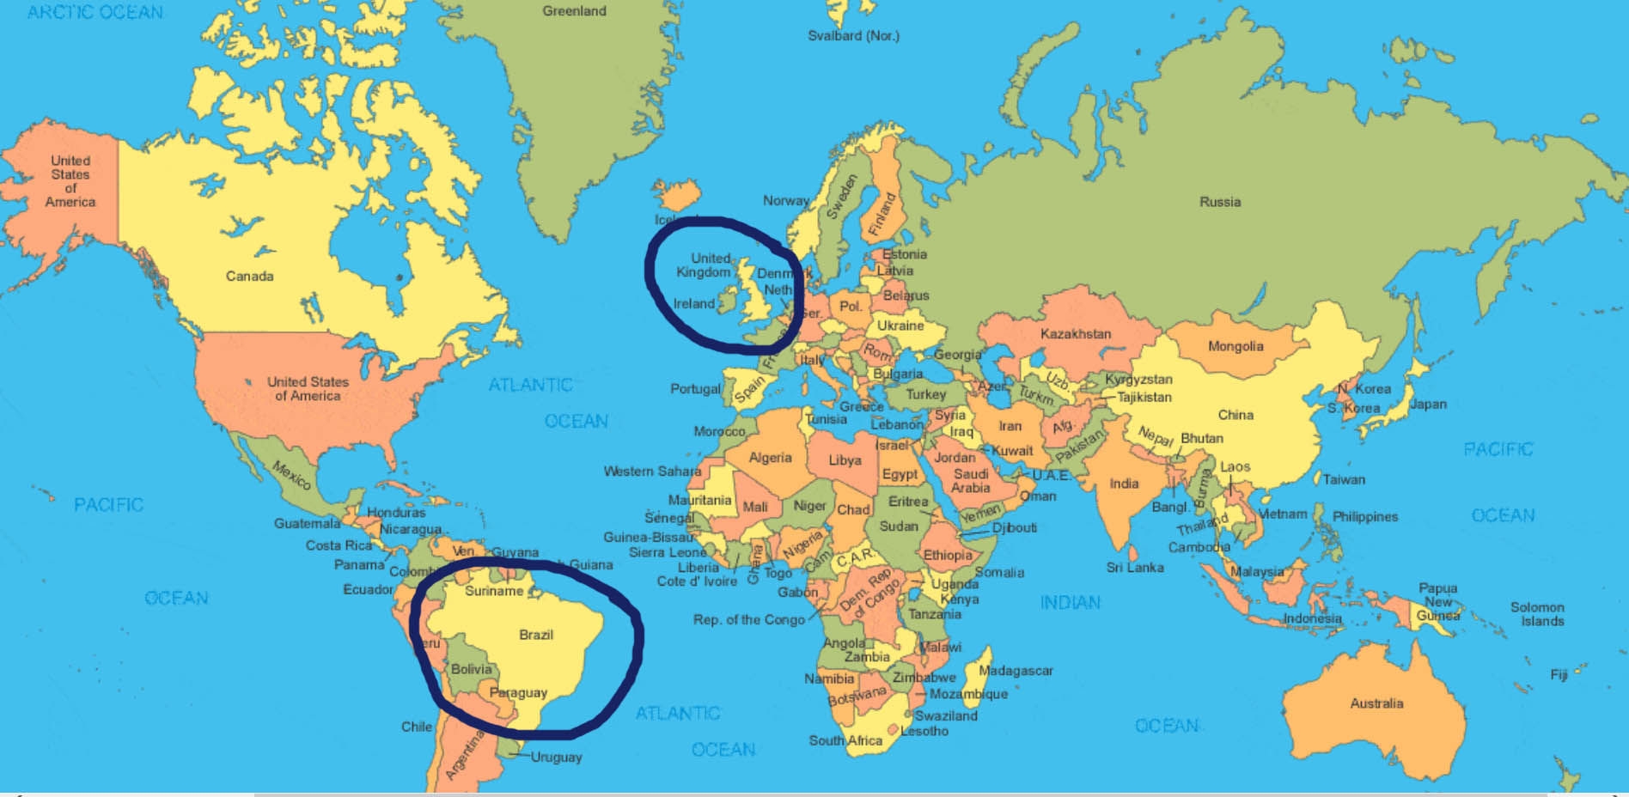
Track 8: Portuguese

Slide 3

Track 8: Portuguese

Slide 4
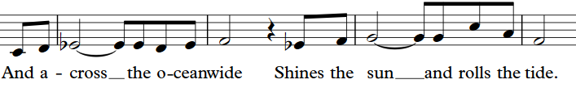
Portuguese 1.1

Slide 5
Portuguese 1.1

Slide 6
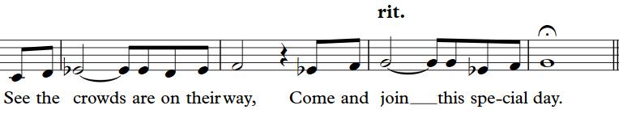
Portuguese 1.2

Slide 7
Portuguese 1.2

Slide 8
Portuguese 1.3

Slide 9
Portuguese 1.3

Slide 10
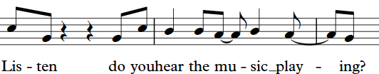
Portuguese 2.1

Slide 11
Portuguese 2.1

Slide 12
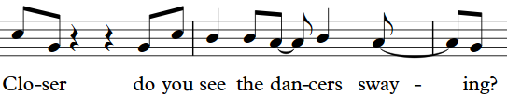
Portuguese 2.2

Slide 13
Portuguese 2.2

Slide 14
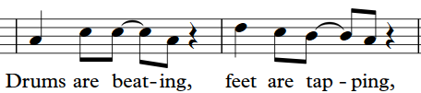
Portuguese 2.3

Slide 15
Portuguese 2.3

Slide 16
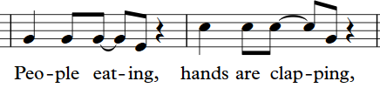
Portuguese 2.4

Slide 17
Portuguese 2.4

Slide 18
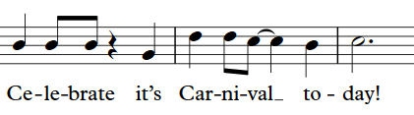
Portuguese 2.5

Slide 19
Portuguese 2.5

Slide 20
Portuguese 3.1
Listen, do you hear the Samba pounding?
Closer every street is now resounding.
Children singing, colours swirling,
Bells are ringing, dancers twirling.
Celebrate it’s Carnival today.

Slide 21
Portuguese 3.1
Listen, do you hear the Samba pounding?
Closer every street is now resounding -
Children singing, colours swirling,
Bells are ringing, dancers twirling,
Celebrate it’s Carnival today.

Slide 22
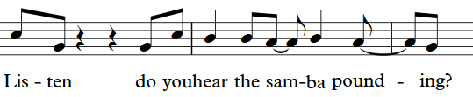
Portuguese 3.1

Slide 23
Portuguese 3.1

Slide 24
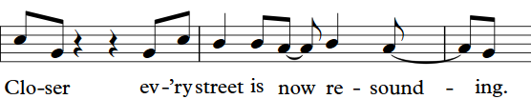
Portuguese 3.2

Slide 25
Portuguese 3.2

Slide 26
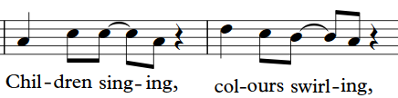
Portuguese 3.3

Slide 27
Portuguese 3.3

Slide 28
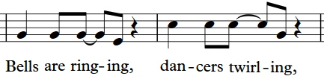
Portuguese 3.4

Slide 29
Portuguese 3.4

Slide 30
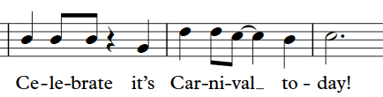
Portuguese 3.5

Slide 31
Portuguese 3.5

Slide 32


Slide 33
Portuguese 4.1
O pião entrou na roda pião (x2)

Slide 34
Portuguese 4.1
O pião entrou na roda pião (x2)

Slide 35
Portuguese 4.2
Roda pião bambeia pião (x2)

Slide 36
Portuguese 4.2
Roda pião bambeia pião (x2)

Slide 37
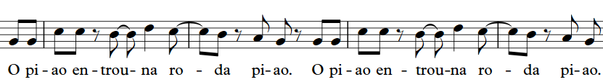
Portuguese 4.3

Slide 38
Portuguese 4.3

Slide 39
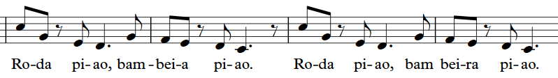
Portuguese 4.4

Slide 40
Portuguese 4.4

Slide 41
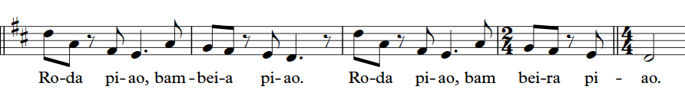
Portuguese 4.5

Slide 42
Portuguese 4.5

Slide 45
Well done!
Click return to begin again, arrows to move back or click to go to a track below:
Track 1 - Chorus
Track 2 – Pre-chorus
Track 3 – Opening and Mandarin
Track 4 – Punjabi/Urdu
Track 5 – Arabic
Track 6 - Polish
Track 7 – Swahili
Track 8 – Portuguese
Track 9 – Altogether! Full Run

