Slide 1
We are Children of the World
Track 7: Swahili
A multi-lingual music project celebrating the many languages of young people in this country.
Click to begin slide

Slide 2
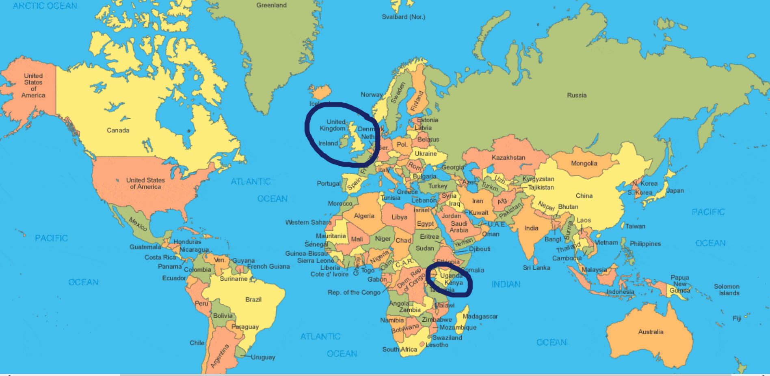
Track 7: Swahili

Slide 3

Track 7: Swahili

Slide 4
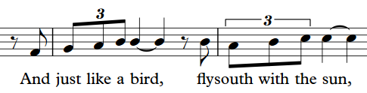
Swahili 1.1

Slide 5
Swahili 1.1

Slide 6
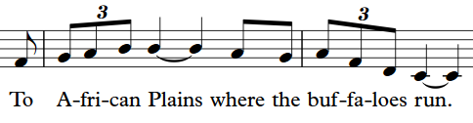
Swahili 1.2

Slide 7
Swahili 1.2

Slide 8
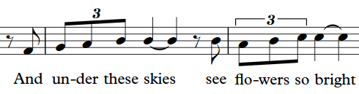
Swahili 1.3

Slide 9
Swahili 1.3

Slide 10
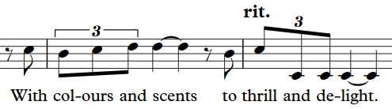
Swahili 1.4

Slide 11
Swahili 1.4

Slide 12


Slide 13
Swahili 2.1
Maua mazuri ya-pen-de-za

Slide 14
Swahili 2.1
Maua mazuri ya-pen-de-za

Slide 15
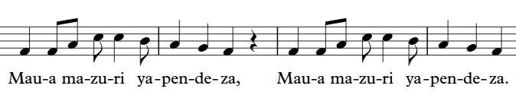
Swahili 2.2

Slide 16
Swahili 2.2

Slide 17
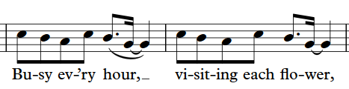
Swahili 2.3

Slide 18
Swahili 2.3

Slide 19
Swahili 2.4
Ha-ku-na mm-o-ja
a-si-ye-pen-de-zwa

Slide 20
Swahili 2.4
Ha-ku-na mm-o-ja
a-si-ye-pen-de-zwa

Slide 21

Swahili 2.5

Slide 22
Swahili 2.5

Slide 24
Swahili 3.1
Zuum, zuum, zuum,
nyu-ki li-a wee

Slide 25
Swahili 3.1
Zuum, zuum, zuum,
nyu-ki li-a wee

Slide 26
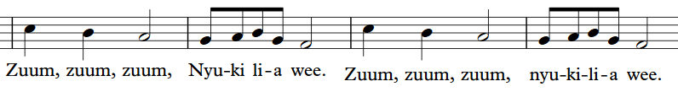
Swahili 3.2

Slide 27
Swahili 3.2

Slide 28
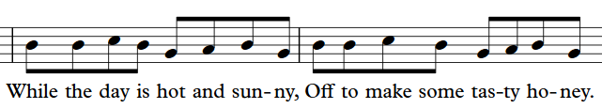
Swahili 3.3

Slide 29
Swahili 3.3

Slide 30
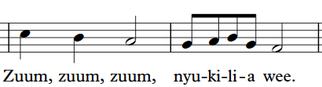
Swahili 3.4

Slide 31
Swahili 3.4

Slide 32
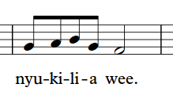
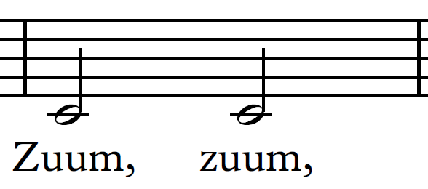
Swahili 3.5

Slide 33
Swahili 3.5

Slide 35
Well done!
Click return to begin again, arrows to move back or click to go to a track below:
Track 1 - Chorus
Track 2 – Pre-chorus
Track 3 – Opening and Mandarin
Track 4 – Punjabi/Urdu
Track 5 – Arabic
Track 6 - Polish
Track 7 – Swahili
Track 8 – Portuguese
Track 9 – Altogether! Full Run

