Slide 1
We are Children of the World
Track 3: Opening and Mandarin
A multi-lingual music project celebrating the many languages of young people in this country.
Click to begin slide

Slide 2
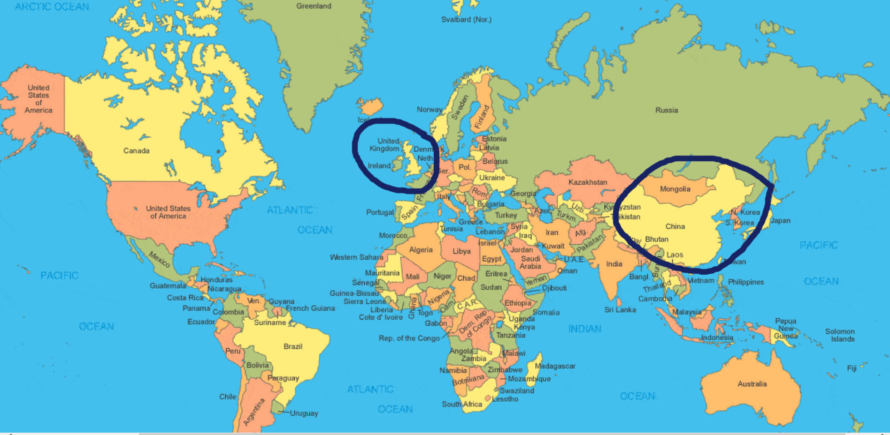
Track 3: Opening and Mandarin

Slide 3

Track 3: Opening and Mandarin

Slide 4
Opening 1.0
Sunrise in the East,
Yellow, warm and bright.
Sunrise, morning glow,
Giving life, bringing light.

Slide 5
Opening 1.0
Sunrise in the East,
Yellow, warm and bright.
Sunrise, morning glow,
Giving life, bringing light.

Slide 6
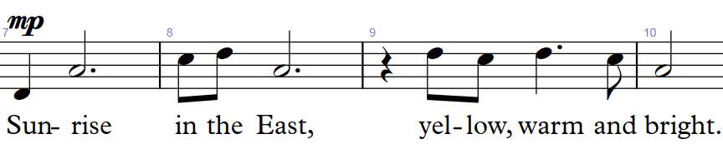
Opening 1.1

Slide 7
Opening 1.1

Slide 8
Opening 1.2

Slide 9
Opening 1.2

Slide 10
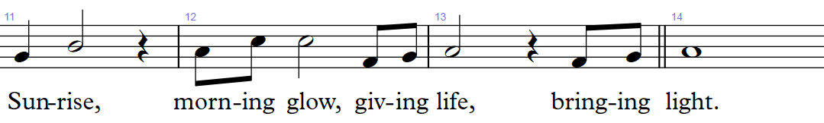
Opening 1.3

Slide 11
Opening 1.3

Slide 12
Opening 1.4

Slide 13
Opening 1.4

Slide 14


Slide 15
Mandarin 1.1
Hao yi duo mei li
de mo li hua

Slide 16
Mandarin 1.1
Hao yi duo mei li
de mo li hua

Slide 17
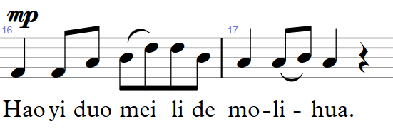
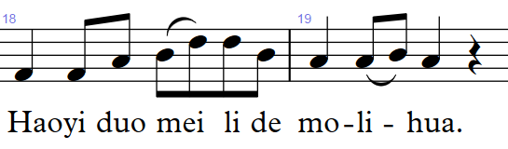
Mandarin 1.2

Slide 18
Mandarin 1.2

Slide 19
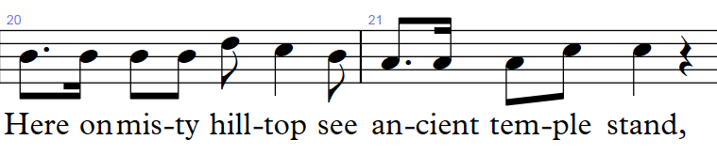
Mandarin 1.3

Slide 20
Mandarin 1.3

Slide 21
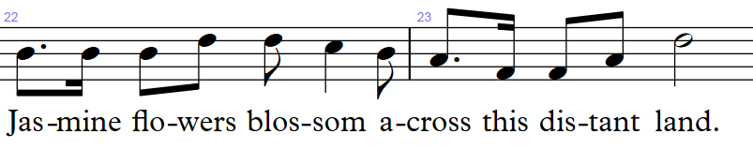
Mandarin 1.4

Slide 22
Mandarin 1.4

Slide 25
Well done!
Click return to begin again, arrows to move back or click to go to a track below:
Track 1 - Chorus
Track 2 – Pre-chorus
Track 3 – Opening and Mandarin
Track 4 – Punjabi/Urdu
Track 5 – Arabic
Track 6 - Polish
Track 7 – Swahili
Track 8 – Portuguese
Track 9 – Altogether! Full Run

