Slide 1
We are Children of the World
Track 5: Arabic
A multi-lingual music project celebrating the many languages of young people in this country.
Click to begin slide

Slide 2
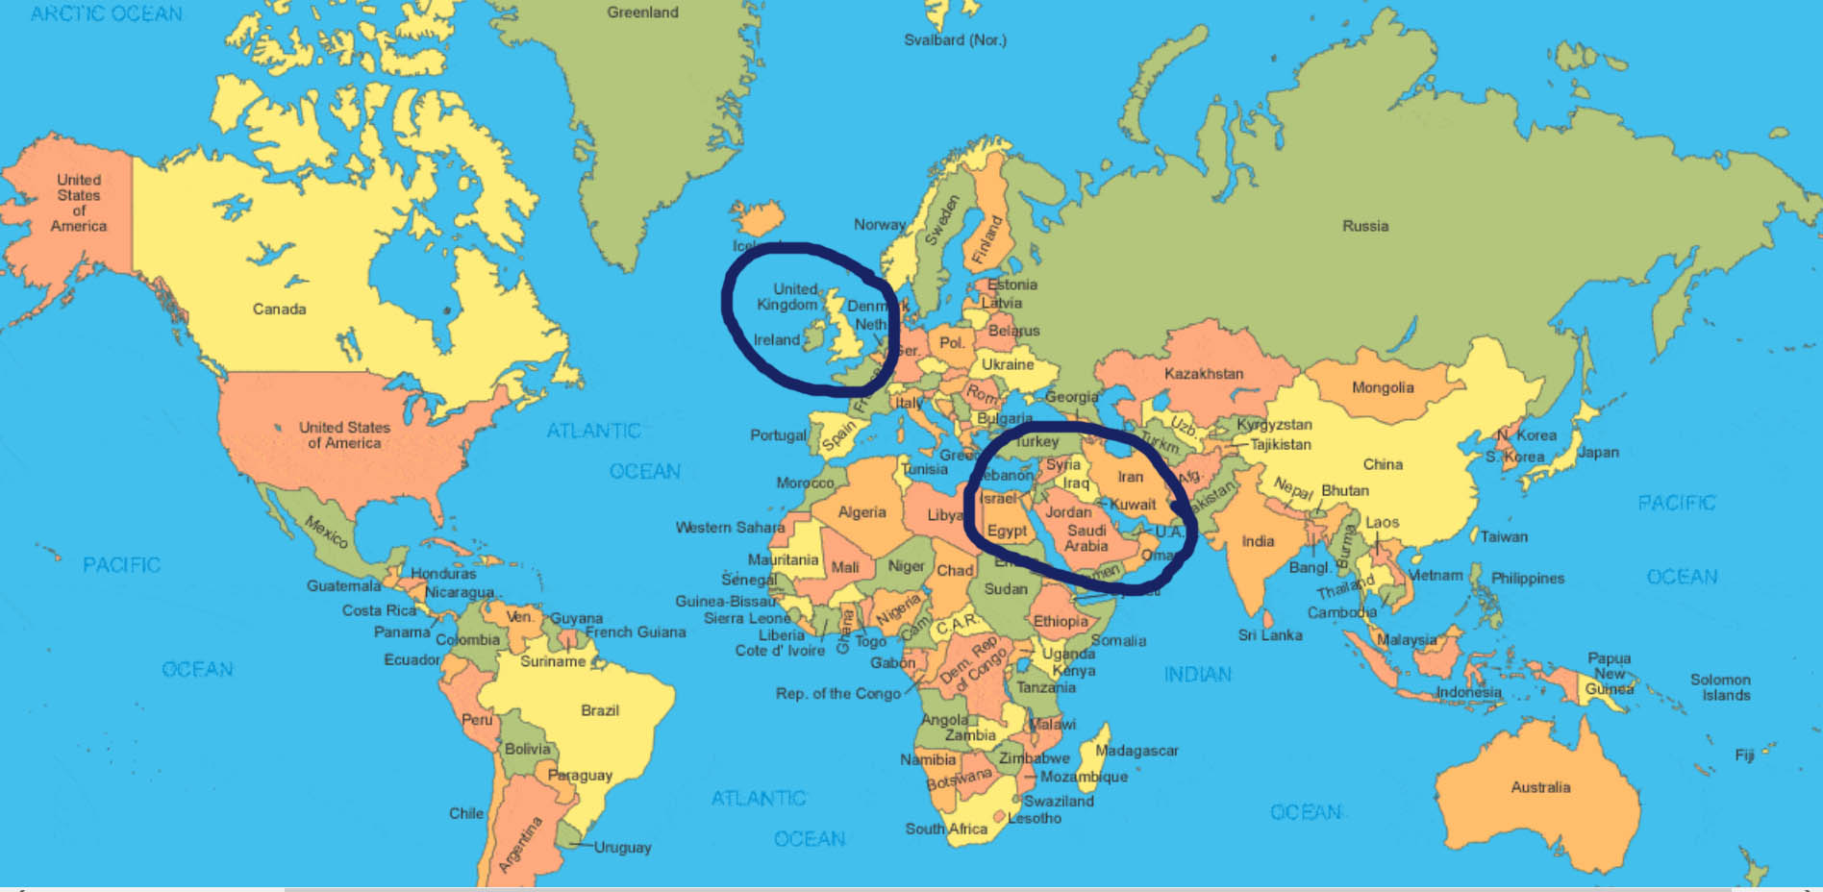
Track 5: Arabic

Slide 3

Track 5: Arabic

Slide 4
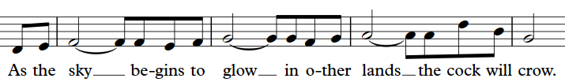
Introduction 1.1

Slide 5
Introduction 1.1

Slide 6
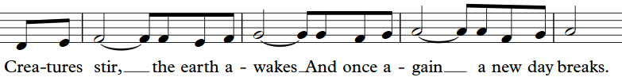
Introduction 1.2

Slide 7
Introduction 1.2

Slide 8
Arabic 1.1
Has-‘see sann* (tongue clicks)
Shoo hel ween (tongue clicks)
*phonetic spelling

Slide 9
Arabic 1.1
Has-‘see sann* (tongue clicks)
shoo hel ween (tongue clicks)
*phonetic spelling

Slide 10
Arabic 1.2
Aam bee-doo-roo
hawla emmoun
Mab-soo-teen
(tongue clicks)

Slide 11
Arabic 1.2
Aam bee-doo-roo
hawla emmoun
Mab-soo-teen
(tongue clicks)

Slide 12
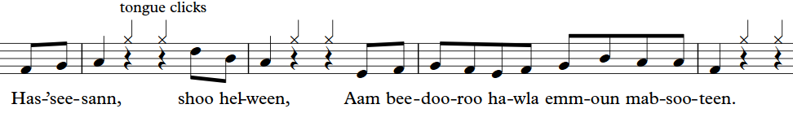
Arabic 1.3

Slide 13
Arabic 1.3

Slide 14
Arabic 2.1
Ma-beek-ha-foo
la la
shoo ma sha-foo
la la

Slide 15
Arabic 2.1
Ma-beek-ha-foo
la la
shoo ma sha-foo
la la

Slide 16
Arabic 2.2
Em-moun had-doun
Hen-nee had-da
Fer-han-een

Slide 17
Arabic 2.2
Em-moun had-doun
Hen-nee had-da
Fer-han-een

Slide 18
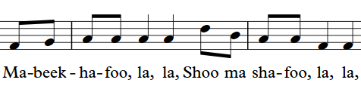
Arabic 2.3

Slide 19
Arabic 2.3

Slide 20
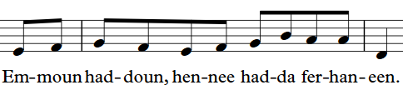
Arabic 2.4

Slide 21
Arabic 2.4

Slide 22


Slide 25
Well done!
Click return to begin again, arrows to move back or click to go to a track below:
Track 1 - Chorus
Track 2 – Pre-chorus
Track 3 – Opening and Mandarin
Track 4 – Punjabi/Urdu
Track 5 – Arabic
Track 6 - Polish
Track 7 – Swahili
Track 8 – Portuguese
Track 9 – Altogether! Full Run

