Slide 1
We are Children of the World
Track 1: Chorus
A multi-lingual music project celebrating the many languages of young people in this country.
Click to begin slide

Slide 2
Welcome!
Track 1: Chorus

Slide 3

Welcome!
Track 1: Chorus

Slide 4
Chorus 1.0
We are children of the world
We share this planet, share this Earth
We are children of the world
One big multi-coloured family no matter where our birth
Though we speak with many voices, we are joined in harmony
Standing tall, singing out, flying free.

Slide 5
Chorus 1.0
We are children of the world
We share this planet, share this Earth
We are children of the world
One big multi-coloured family no matter where our birth
Though we speak with many voices, we are joined in harmony
Standing tall, singing out, flying free.

Slide 6
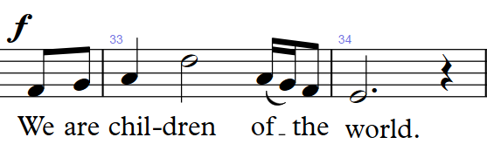
Chorus 1.1

Slide 7
Chorus 1.1

Slide 8
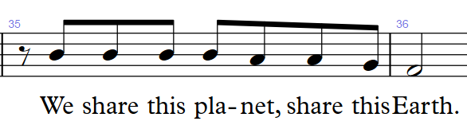
Chorus 1.2

Slide 9
Chorus 1.2

Slide 10
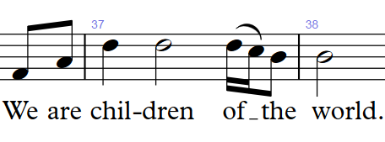
Chorus 1.3

Slide 11
Chorus 1.3

Slide 12
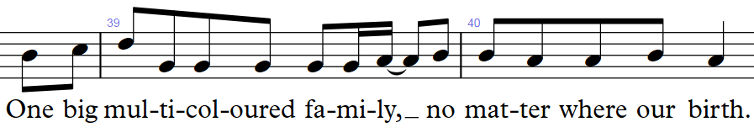
Chorus 1.4

Slide 13
Chorus 1.4

Slide 14

Once loaded, press the red arrow in the middle to play the video
You can repeat this video as many times as you like, then click the arrow on the right when you are ready to move on…

Slide 15
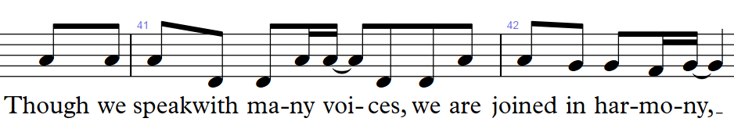
Chorus 2.1

Slide 16
Chorus 2.1

Slide 17
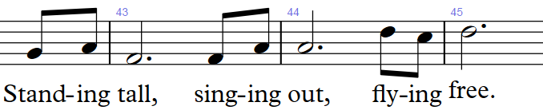
Chorus 2.2

Slide 18
Chorus 2.2

Slide 21
Well done!
Click return to begin again, arrows to move back or click to go to a track below:
Track 1 - Chorus
Track 2 – Pre-chorus
Track 3 – Opening and Mandarin
Track 4 – Punjabi/Urdu
Track 5 – Arabic
Track 6 - Polish
Track 7 – Swahili
Track 8 – Portuguese
Track 9 – Altogether! Full Run

